Slide 1
Objects and Classes
‹#›

Slide 2
OO Programming Concepts
Object-oriented programming (OOP) involves programming using objects. An object represents an entity in the real world that can be distinctly identified. For example, a student, a desk, a circle, a button, and even a loan can all be viewed as objects.
‹#›

Slide 3
OO Programming Concepts
The state of an object (also known as its properties or attributes) is represented by data fields with their current values. A circle object, for example, has a data field radius, which is the property that characterizes a circle. A rectangle object has the data fields width and height, which are the properties that characterize a rectangle
The behavior of an object (also known as its actions) is defined by methods. To invoke a method on an object is to ask the object to perform an action. For example, you may define methods named getArea() and getPerimeter() for circle objects. A circle object may invoke getArea() to return its area and getPerim- eter() to return its perimeter.
‹#›

Slide 4
OO Programming Concepts
Objects of the same type are defined using a common class. A class is a template, blueprint, or contract that defines what an object’s data fields and methods will be. An object is an instance of a class. You can create many instances of a class. Creating an instance is referred to as instantiation.
The terms object and instance are often interchangeable. The relationship between classes and objects is analogous to that between an apple-pie recipe and apple pies: You can make as many apple pies as you want from a single recipe.
‹#›

Slide 5
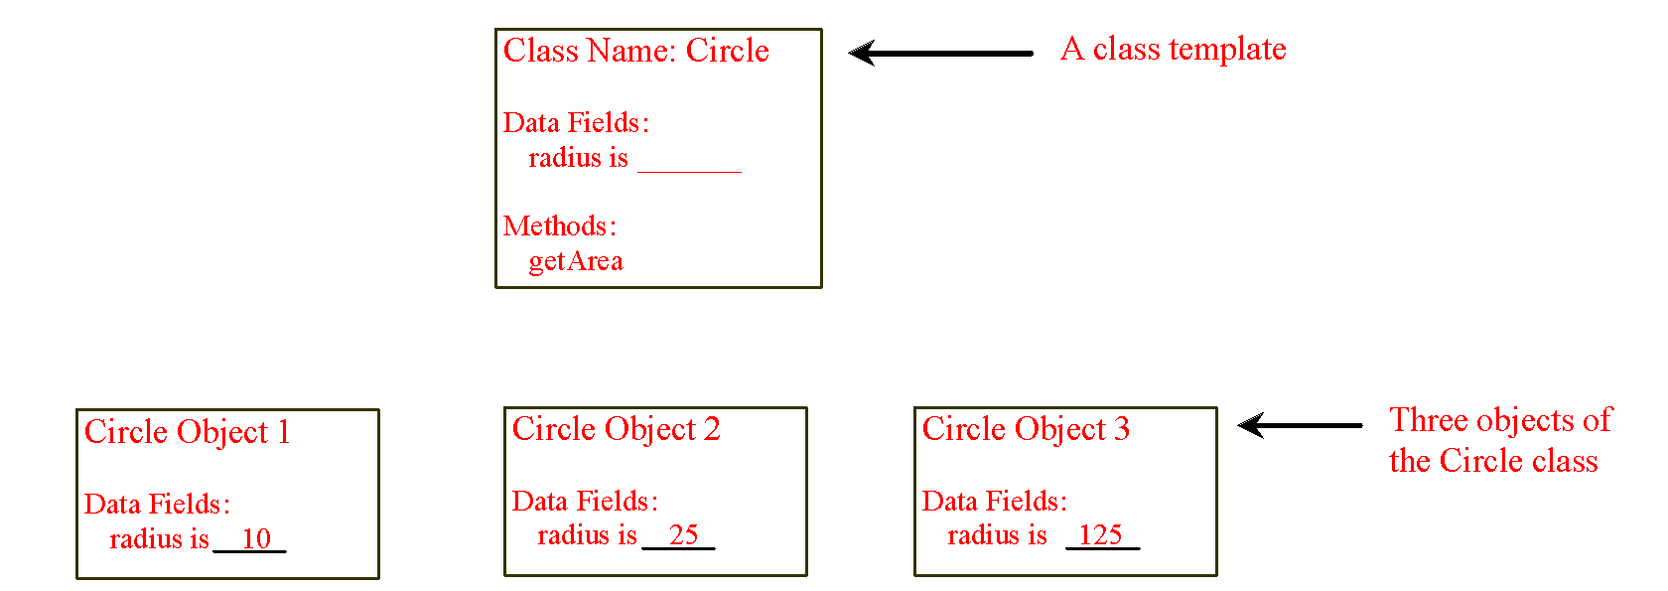
Objects
An object has both a state and behavior. The state defines the object, and the behavior defines what the object does.
‹#›
Notes:
‹#›

Slide 6
Classes
Classes are constructs that define objects of the same type. A Java class uses variables to define data fields and methods to define behaviors. Additionally, a class provides a special type of methods, known as constructors, which are invoked to construct objects from the class.
‹#›

Slide 7
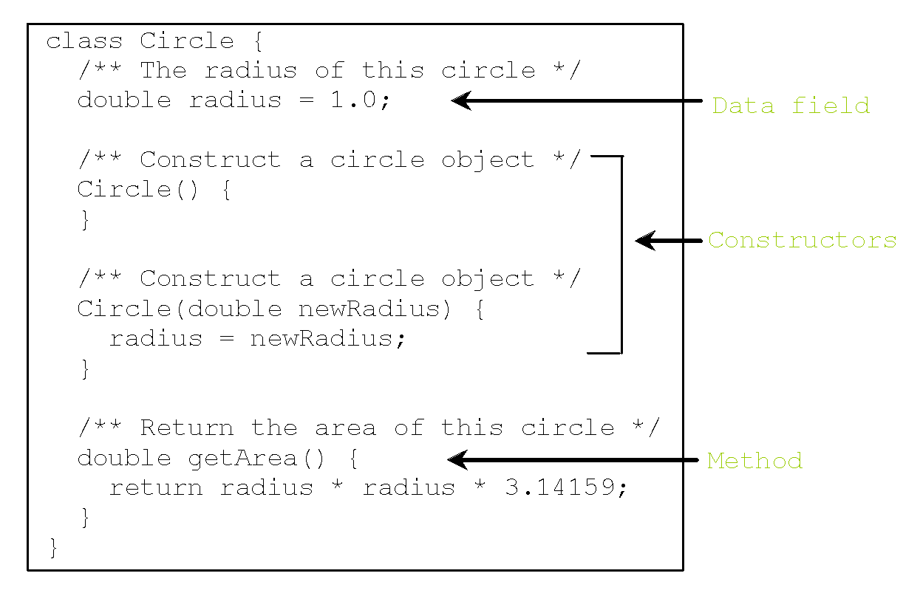
Classes
‹#›

Slide 8
Classes
The Circle class is different from all of the other classes you have seen thus far. It does not have a main method and therefore cannot be run; it is merely a definition for circle objects. The class that contains the main method will be referred to in this book, for convenience, as the main class.
The illustration of class templates and objects in can be standardized using Unified Modeling Language (UML) notation. This notation is called a UML class diagram, or simply a class diagram.
‹#›

Slide 9
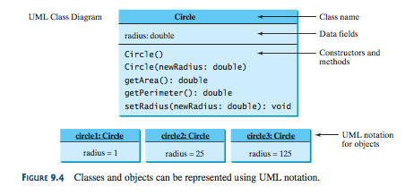
Unified Modeling Language (UML) Class Diagram
In the class diagram, the data field is denoted as
dataFieldName: dataFieldType
The constructor is denoted as:
ClassName(parameterName: parameterType)
The method is denoted as
methodName(parameterName: parameterType): returnType
‹#›

Slide 10
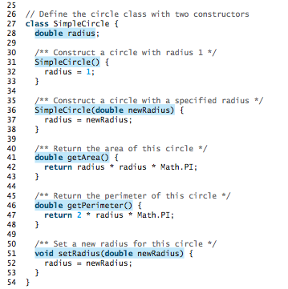
Example: SimpleCircle class
‹#›

Slide 11
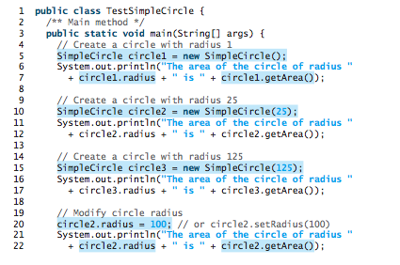

Example: SimpleCircle class
‹#›

Slide 12
Example: SimpleCircle class
The program contains two classes. The first of these, TestSimpleCircle, is the main class. Its sole purpose is to test the second class, SimpleCircle. Such a program that uses the class is often referred to as a client of the class. When you run the program, the Java runtime system invokes the main method in the main class.
You can put the two classes into one file, but only one class in the file can be a public class. Furthermore, the public class must have the same name as the file name. Therefore, the file name is TestSimpleCircle.java, since TestSimpleCircle is public.
Each class in the source code is compiled into a .class file. When you compile TestSimpleCircle.java, two class files TestSimpleCircle.class and SimpleCircle.class are generated,
‹#›

Slide 13
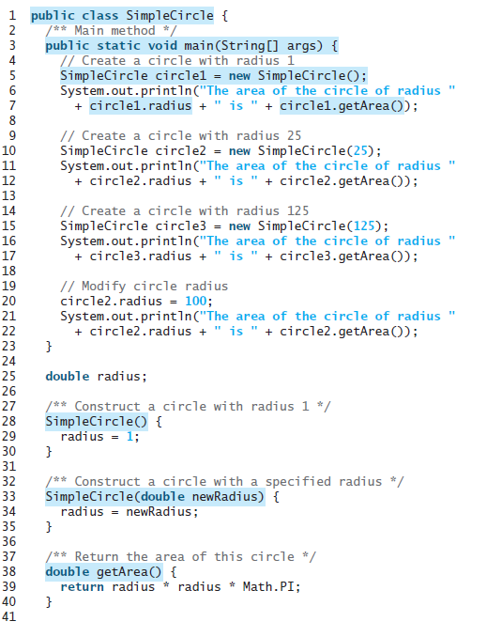
Combine Two Classes into One
‹#›

Slide 14
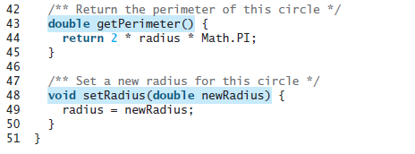
Combine Two Classes into One
‹#›

Slide 15
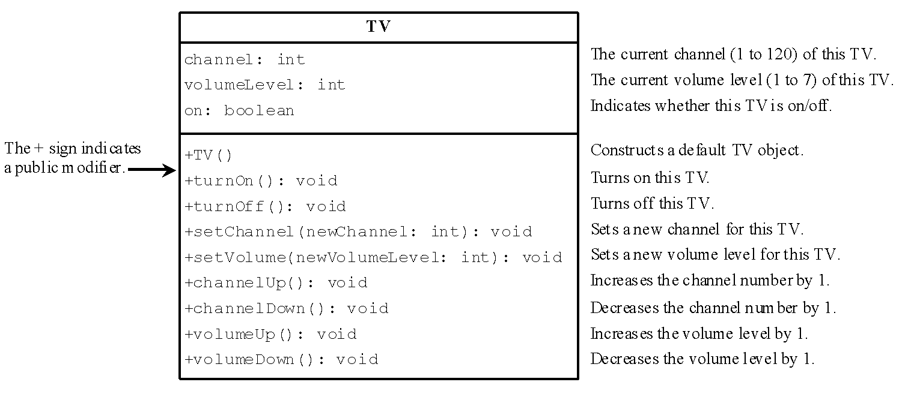
Example: Defining Classes and Creating Objects
The constructor and methods in the TV class are defined public so they can be accessed from other classes.
‹#›

Slide 16
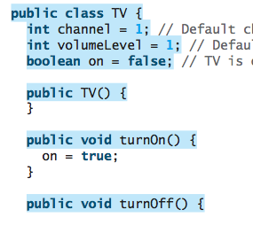
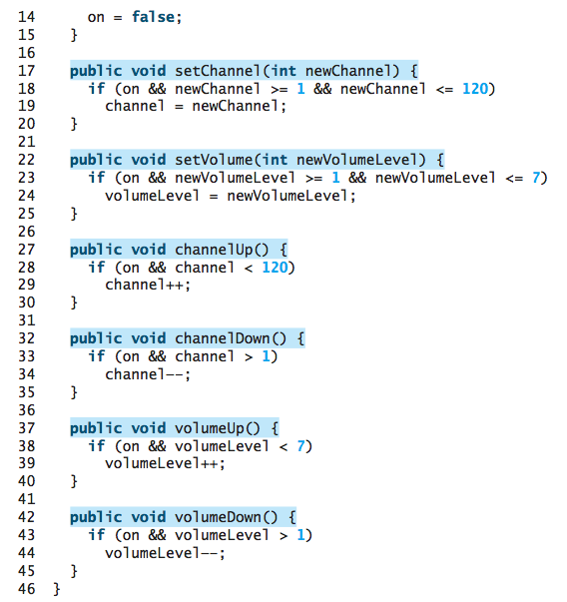
Example: Defining Classes and Creating Objects
‹#›

Slide 17
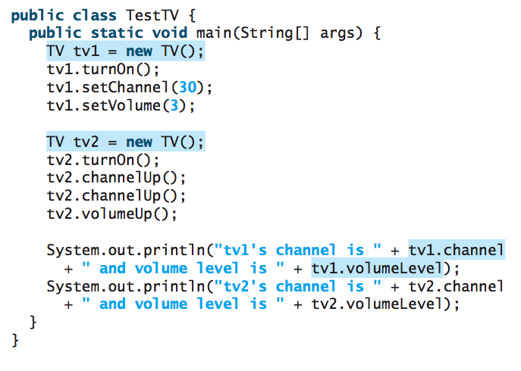
Example: Defining Classes and Creating Objects
‹#›

Slide 18
Constructors
Constructors are a special kind of methods that are invoked to construct objects.
Circle() {
}
Circle(double newRadius) {
radius = newRadius;
}
‹#›

Slide 19
Constructors, cont.
A constructor with no parameters is referred to as a no-arg constructor.
· Constructors must have the same name as the class itself.
· Constructors do not have a return type—not even void.
· Constructors are invoked using the new operator when an object is created. Constructors play the role of initializing objects.
‹#›

Slide 20
Creating Objects Using Constructors
new ClassName();
Example:
new Circle();
new Circle(5.0);
‹#›

Slide 21
Default Constructor
A class may be defined without constructors. In this case, a no-arg constructor with an empty body is implicitly defined in the class. This constructor, called a default constructor, is provided automatically only if no constructors are explicitly defined in the class.
‹#›

Slide 22
Declaring Object Reference Variables
Objects are accessed via the object’s reference variables, which contain references to the objects.
To reference an object, assign the object to a reference variable.
A class is a reference type, which means that a variable of the class type can reference an instance of the class.
To declare a reference variable, use the syntax:
ClassName objectRefVar;
Example:
Circle myCircle;
‹#›

Slide 23
Declaring/Creating Objects in a Single Step
ClassName objectRefVar = new ClassName();
Example:
Circle myCircle = new Circle();
Assign object reference
Create an object
‹#›

Slide 24
Accessing Object’s Members
Referencing the object’s data is done using the dot operator or object member access operator:
objectRefVar.data
e.g., myCircle.radius
Invoking the object’s method:
objectRefVar.methodName(arguments)
e.g., myCircle.getArea()
‹#›

Slide 25
Trace Code
Declare myCircle
Circle myCircle = new Circle(5.0);
Circle yourCircle = new Circle();
yourCircle.radius = 100;
myCircle
no value
‹#›

Slide 26
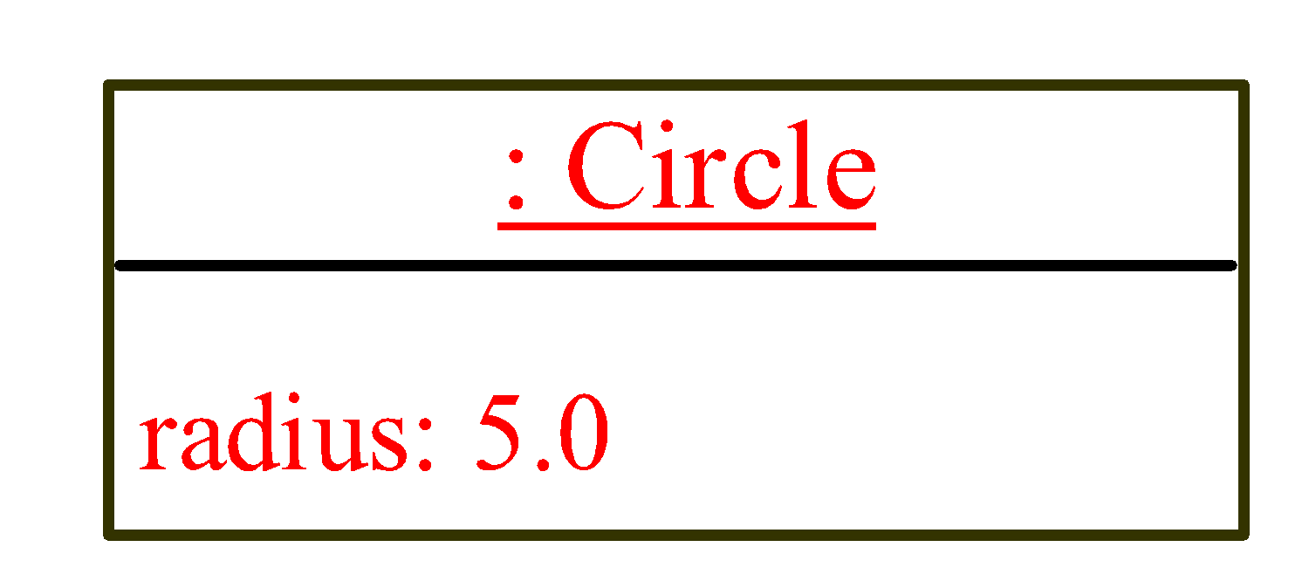
Trace Code, cont.
Circle myCircle = new Circle(5.0);
Circle yourCircle = new Circle();
yourCircle.radius = 100;
myCircle
no value
Create a circle
‹#›

Slide 27
Trace Code, cont.
Circle myCircle = new Circle(5.0);
Circle yourCircle = new Circle();
yourCircle.radius = 100;
myCircle
reference value
Assign object reference to myCircle
‹#›

Slide 28
Trace Code, cont.
Circle myCircle = new Circle(5.0);
Circle yourCircle = new Circle();
yourCircle.radius = 100;
myCircle
reference value
yourCircle
no value
Declare yourCircle
‹#›

Slide 29
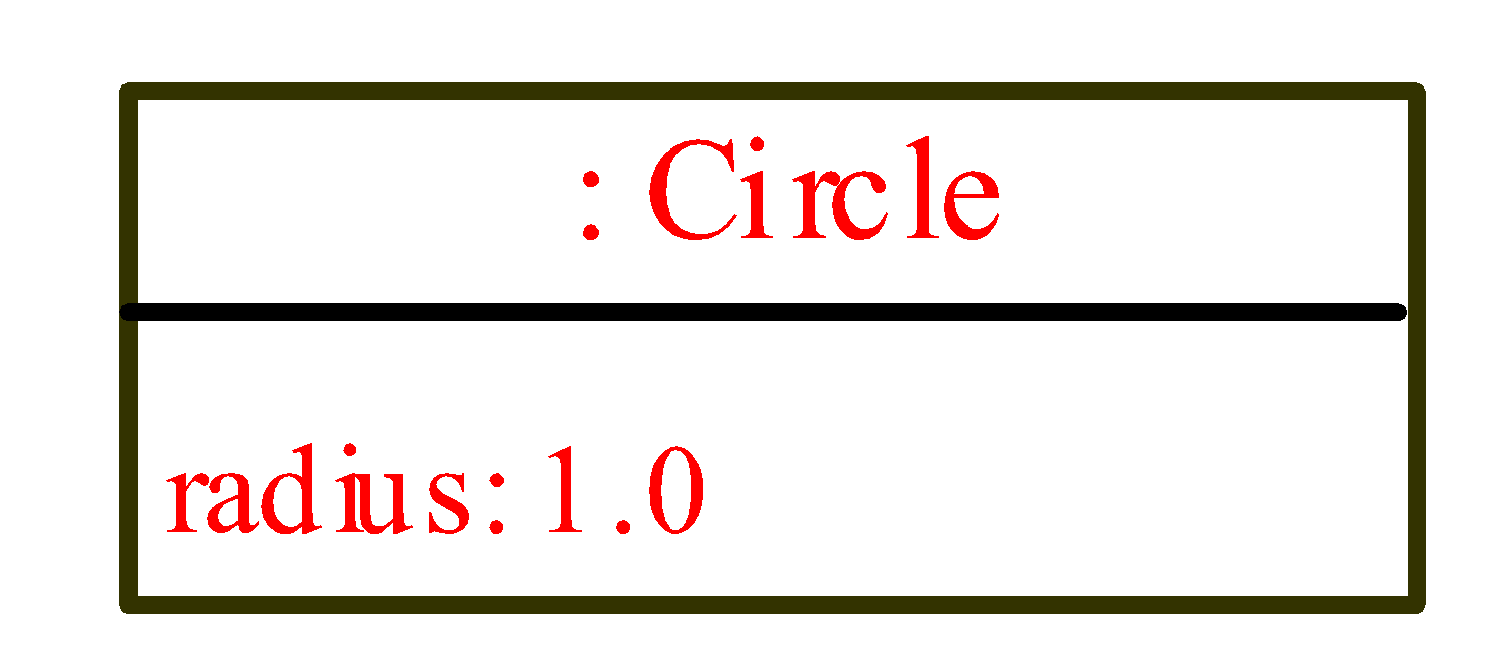
Trace Code, cont.
Circle myCircle = new Circle(5.0);
Circle yourCircle = new Circle();
yourCircle.radius = 100;
myCircle
reference value
yourCircle
no value
Create a new Circle object
‹#›

Slide 30
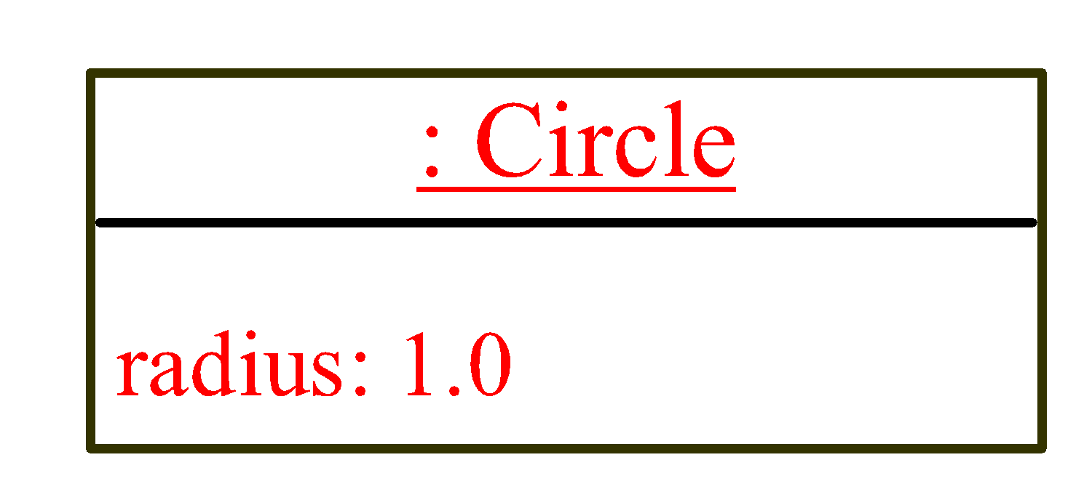
Trace Code, cont.
Circle myCircle = new Circle(5.0);
Circle yourCircle = new Circle();
yourCircle.radius = 100;
myCircle
reference value
yourCircle
reference value
Assign object reference to yourCircle
‹#›

Slide 31
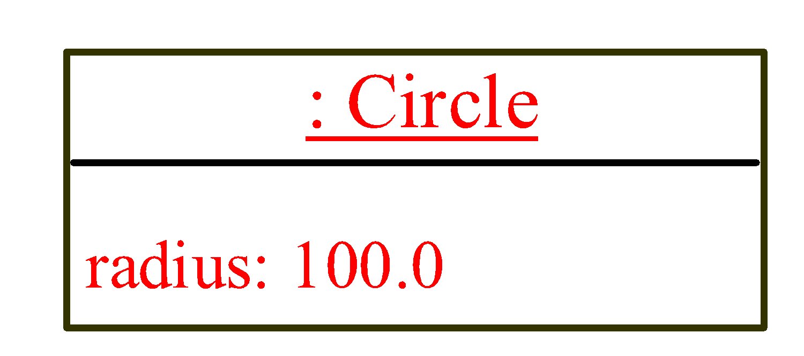
Trace Code, cont.
Circle myCircle = new Circle(5.0);
Circle yourCircle = new Circle();
yourCircle.radius = 100;
myCircle
reference value
yourCircle
reference value
Change radius in yourCircle
‹#›

Slide 32
Caution
The data field radius is referred to as an instance variable, because it is dependent on a specific instance. For the same reason, the method getArea is referred to as an instance method, because you can invoke it only on a specific instance.
The object on which an instance method is invoked is called a calling object.
‹#›

Slide 33
Caution
Recall that you use
Math.methodName(arguments) (e.g., Math.pow(3, 2.5))
to invoke a method in the Math class. Can you invoke getArea() using SimpleCircle.getArea()? The answer is no.
All the methods used before this chapter are static methods, which are defined using the static keyword. However, getArea() is non-static. It must be invoked from an object using
objectRefVar.methodName(arguments) (e.g., myCircle.getArea()).
‹#›

Slide 34
Reference Data Fields
The data fields can be of reference types. For example, the following Student class contains a data field name of the String type.
public class Student {
String name; // name has default value null
int age; // age has default value 0
boolean isScienceMajor; // isScienceMajor has default value false
char gender; // c has default value '\u0000'
}
‹#›

Slide 35
The null Value
If a data field of a reference type does not reference any object, the data field holds a special literal value, null.
‹#›

Slide 36
Default Value for a Data Field
The default value of a data field is null for a reference type, 0 for a numeric type, false for a boolean type, and '\u0000' for a char type. However, Java assigns no default value to a local variable inside a method.
public class Test {
public static void main(String[] args) {
Student student = new Student();
System.out.println("name? " + student.name);
System.out.println("age? " + student.age);
System.out.println("isScienceMajor? " + student.isScienceMajor);
System.out.println("gender? " + student.gender);
}
}
‹#›

Slide 37
Example
Java assigns no default value to a local variable inside a method.
public class Test {
public static void main(String[] args) {
int x; // x has no default value
String y; // y has no default value
System.out.println("x is " + x);
System.out.println("y is " + y);
}
}
Compile error: variable not initialized
‹#›

Slide 38
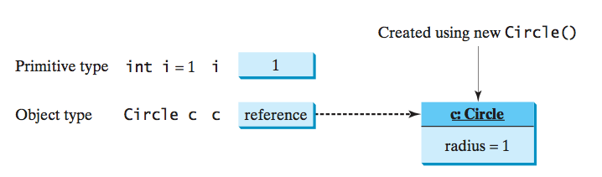
Differences between Variables of Primitive Data Types and Object Types
Every variable represents a memory location that holds a value. When you declare a variable, you are telling the compiler what type of value the variable can hold. For a variable of a primitive type, the value is of the primitive type. For a variable of a reference type, the value is a reference to where an object is located.
‹#›

Slide 39
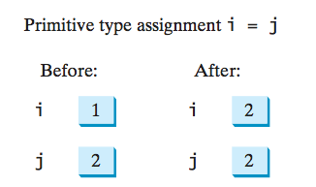
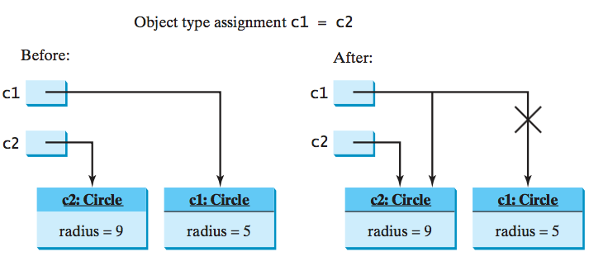
Copying Variables of Primitive Data Types and Object Types
‹#›

Slide 40
Garbage Collection
As shown in the previous figure, after the assignment statement c1 = c2, c1 points to the same object referenced by c2. The object previously referenced by c1 is no longer referenced. This object is known as garbage. Garbage is automatically collected by JVM.
‹#›

Slide 41
Garbage Collection, cont
TIP: If you know that an object is no longer needed, you can explicitly assign null to a reference variable for the object. The JVM will automatically collect the space if the object is not referenced by any variable.
‹#›

Slide 42
Instance Variables, and Methods
Instance variables belong to a specific instance.
Instance methods are invoked by any instance of the class.
‹#›

Slide 43
Static Variables, Constants, and Methods
Static variables are shared by all the instances of the class.
Static methods are not tied to a specific object. Because of this, a static method cannot access instance members of the class
Static constants are final variables shared by all the instances of the class.
A non-static (or instance) variable is tied to a specific instance
‹#›

Slide 44
Static Variables, Constants, and Methods
Static variables store values for the variables in a common memory location. Because of this common location, if one object changes the value of a static variable, all objects of the same class are affected.
Java supports static methods as well as static variables. Static methods can be called without creating an instance of the class.
‹#›

Slide 45
Static Variables, Constants, and Methods, cont.
To declare static variables, constants, and methods, use the static modifier. For example, the constant PI in the Math class is defined as
final static double PI=3.14159265358979323846
Let’s modify the Circle class by adding a static variable numberOfObjects to count the number of circle objects created. When the first object of this class is created, numberOfObjects is 1. When the second object is created, numberOfObjects becomes 2. The UML of the new circle class is shown below
‹#›

Slide 46

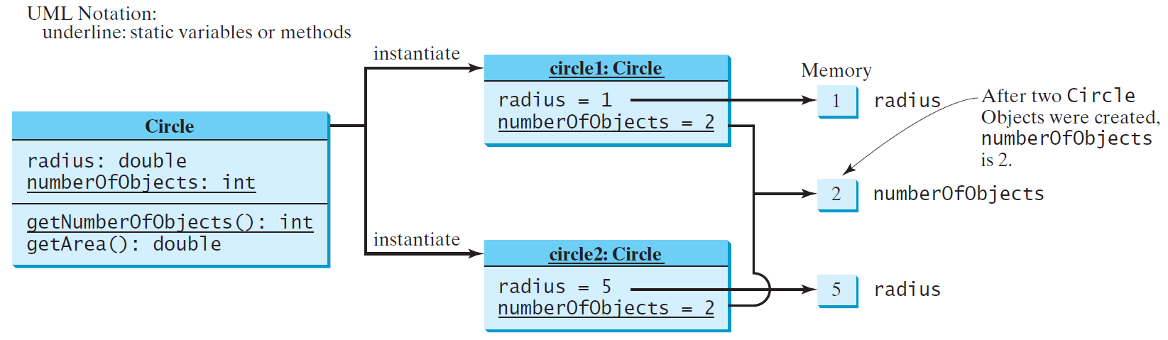
Static Variables, Constants, and Methods, cont.
‹#›

Slide 47
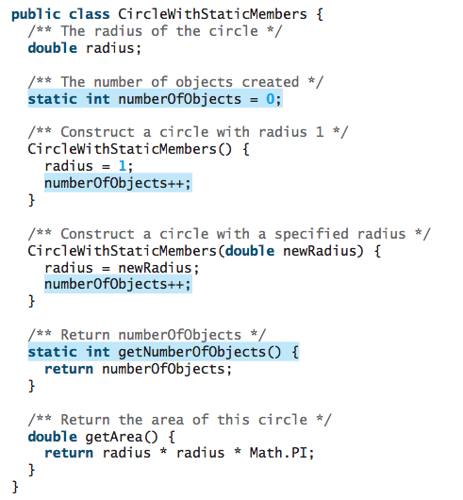
CircleWithStaticMembers Class
‹#›

Slide 48
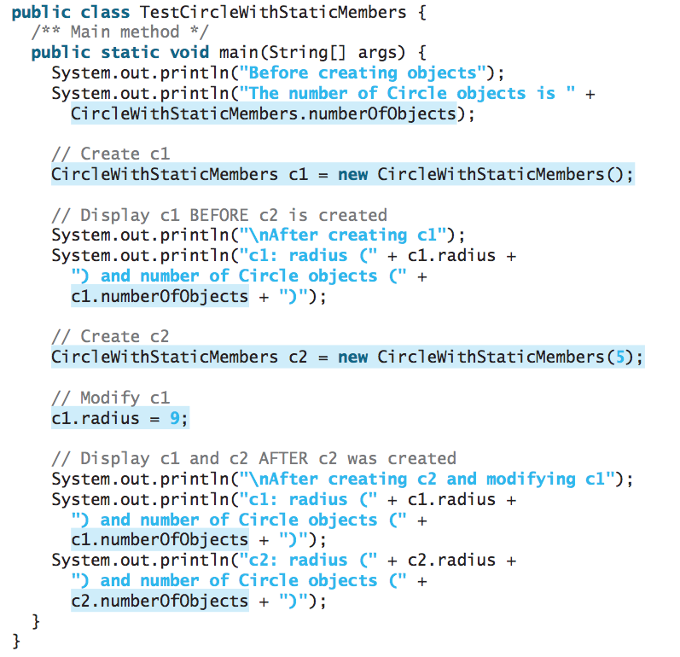
TestCircleWithStaticMembers.java
Static variables and methods can be accessed without creating objects. Line 6 displays the number of objects, which is 0, since no objects have been created.
‹#›

Slide 49
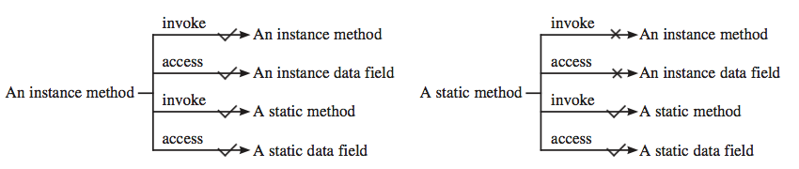
Static and Instance Methods
An instance method can invoke an instance or static method and access an instance or static data field. A static method can invoke a static method and access a static data field. However, a static method cannot invoke an instance method or access an instance data field, since static methods and static data fields don’t belong to a particular object.
‹#›

Slide 50
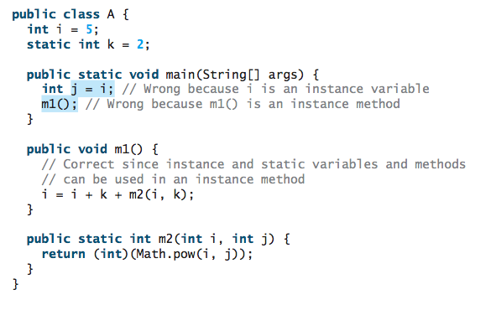
Examples
‹#›

Slide 51
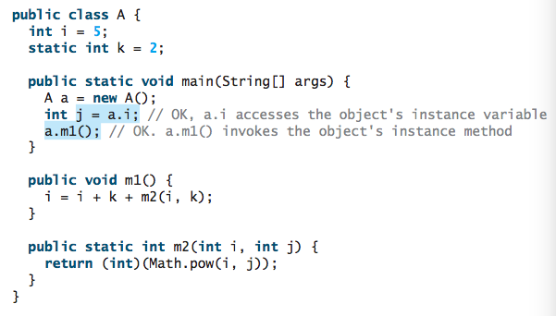
Examples
‹#›

Slide 52
Visibility Modifiers and Accessor/Mutator Methods
You can use the public visibility modifier for classes, methods, and data fields to denote that they can be accessed from any other classes.
If no visibility modifier is used, then by default the classes, methods, and data fields are accessible by any class in the same package. This is known as package-private or package-access.
Packages can be used to organize classes. To do so, you need to add the following line as the first statement in the program:
package packageName;
If a class is defined without the package statement, it is said to be placed in the default package.
‹#›

Slide 53
Visibility Modifiers and Accessor/Mutator Methods
By default, the class, variable, or method can be accessed by any class in the same package.
public
The class, data, or method is visible to any class in any package.
private
The data or methods can be accessed only by the declaring class.
Public getter (Accessor) and setter (Mutator) methods are used to read and modify private properties.
‹#›

Slide 54
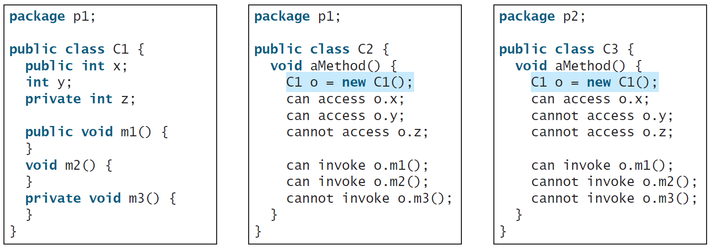
Examples
The private modifier restricts access to within a class,
The default modifier restricts access to within a package,
The public modifier enables unrestricted access.
‹#›

Slide 55
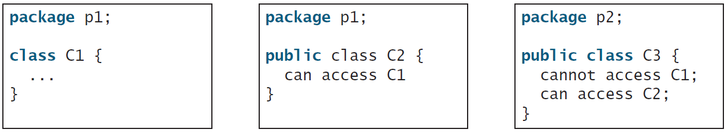
Visibility Modifier of Classes
The default modifier on a class restricts access to within a package
The public modifier enables unrestricted access.
‹#›

Slide 56
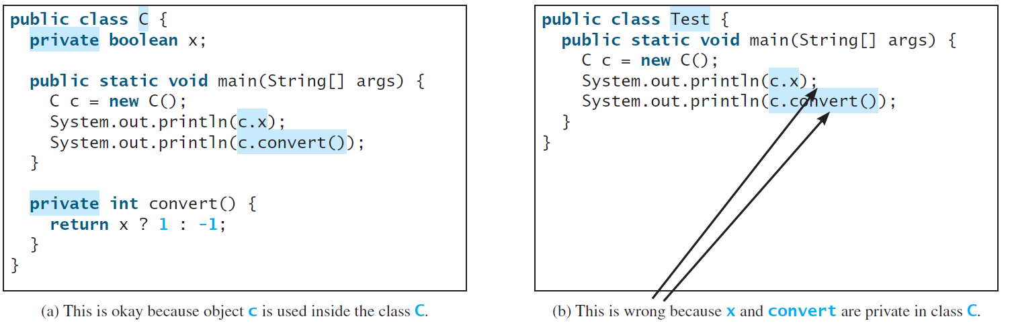
NOTE
An object cannot access its private members, as shown in (b). It is OK, however, if the object is declared in its own class, as shown in (a).
‹#›

Slide 57
NOTE
The private modifier applies only to the members of a class. The public modifier can apply to a class or members of a class. Using the modifiers public and private on local variables would cause a compile error.
In most cases, the constructor should be public. However, if you want to prohibit the user from creating an instance of a class, use a private constructor. For example, there is no reason to create an instance from the Math class, because all of its data fields and methods are static. To prevent the user from creating objects from the Math class, the constructor in java.lang.Math is defined as private.
‹#›

Slide 58
Data Field Encapsulation
Making data fields private protect data.
Making data fields private helps to make code easy to maintain since the client programs cannot modify them.
To prevent direct modifications of data fields, declaring the data fields private is known as data field encapsulation.
To make a private data field accessible, provide a getter method to return its value. To enable a private data field to be updated, provide a setter method to set a new value. A getter method is also referred to as an accessor and a setter to a mutator.
‹#›

Slide 59
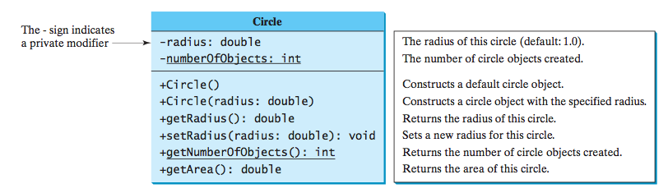
Example of Data Field Encapsulation
‹#›

Slide 60
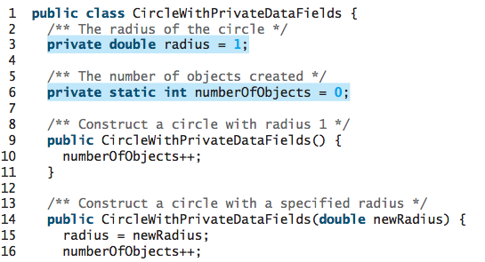
Example of Data Field Encapsulation
‹#›

Slide 61
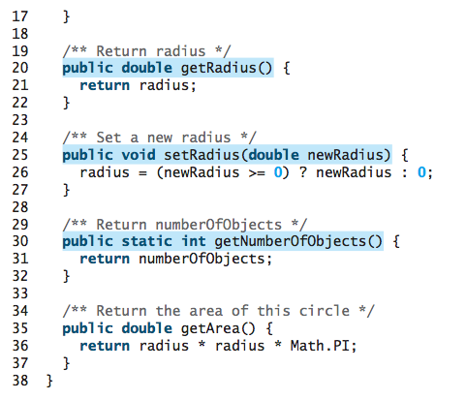
Example of Data Field Encapsulation
‹#›

Slide 62
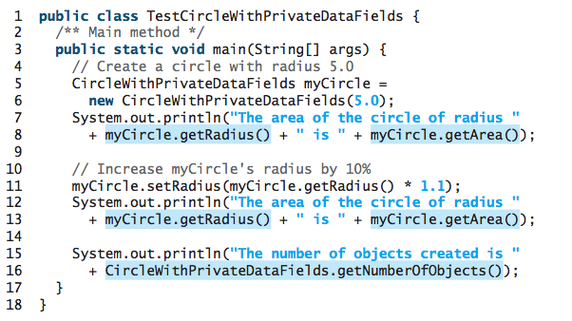
Example of Data Field Encapsulation
‹#›

Slide 63
Passing Objects to Methods
Passing by value for primitive type value (the value is passed to the parameter)
Passing by value for reference type value (the value is the reference to the object)
‹#›

Slide 64
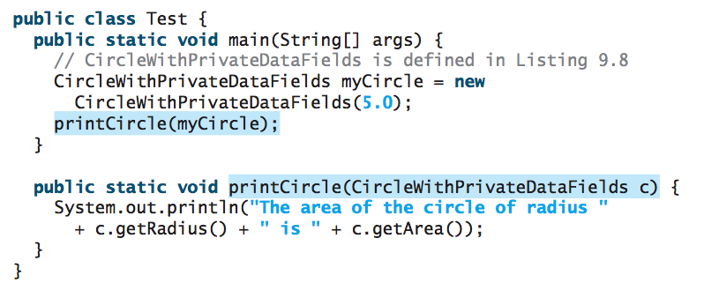
Passing Objects to Methods
‹#›

Slide 65
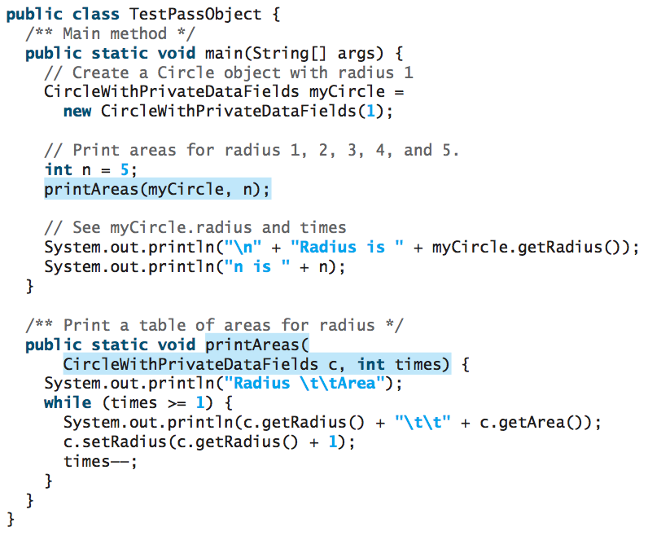
Passing a primitive type value and a reference value
‹#›

Slide 66
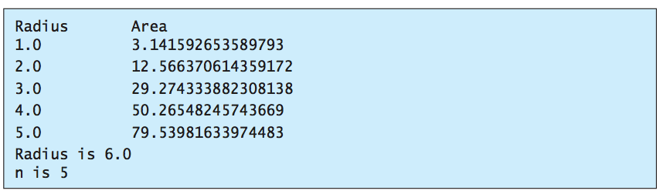
Passing a primitive type value and a reference value
When passing an argument of a reference type, the reference of the object is passed. In this case, c contains a reference for the object that is also referenced via myCircle. Therefore, changing the properties of the object through c inside the printAreas method has the same effect as doing so outside the method through the variable myCircle. Pass-by-value on references can be best described semantically as pass-by-sharing; that is, the object referenced in the method is the same as the object being passed.
‹#›

Slide 67
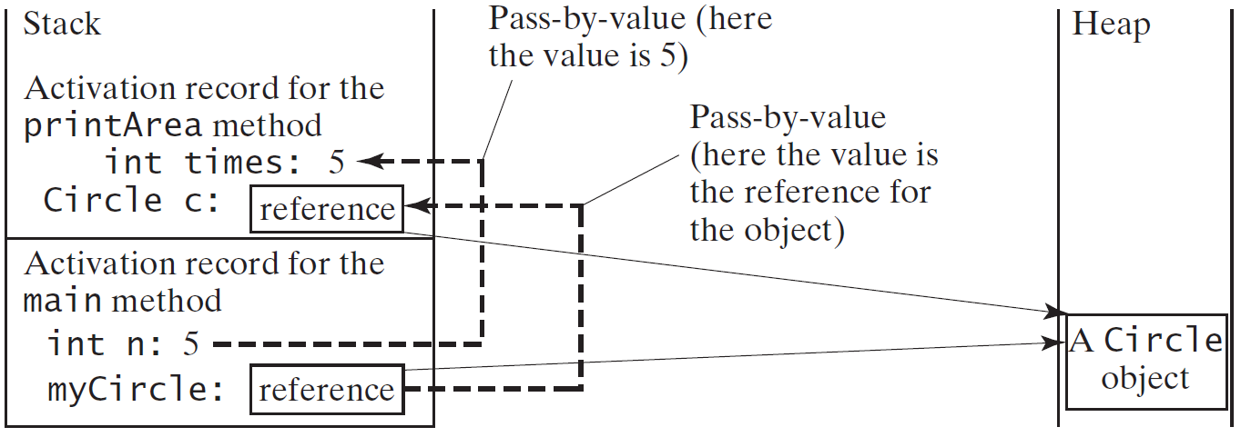
Passing Objects to Methods
‹#›

Slide 68
Array of Objects
Circle[] circleArray = new Circle[10];
An array of objects is actually an array of reference variables. So invoking circleArray[1].getArea() involves two levels of referencing as shown in the next figure. circleArray references to the entire array. circleArray[1] references to a Circle object.
‹#›

Slide 69
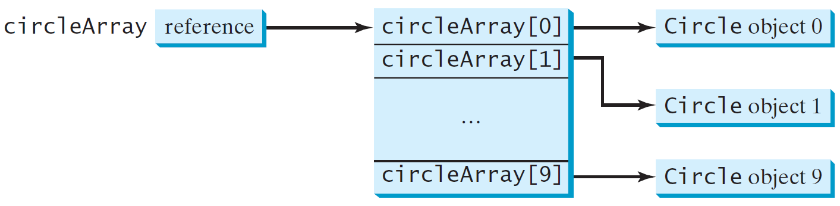
Array of Objects
Circle[] circleArray = new Circle[10];
‹#›

Slide 70
Array of Objects
To initialize circleArray, you can use a for loop
for (int i = 0; i < circleArray.length; i++) {
circleArray[i] = new Circle();
}
An array of objects is actually an array of reference variables.
When an array of objects is created using the new operator, each element in the array is a reference variable with a default value of null.
‹#›

Slide 71
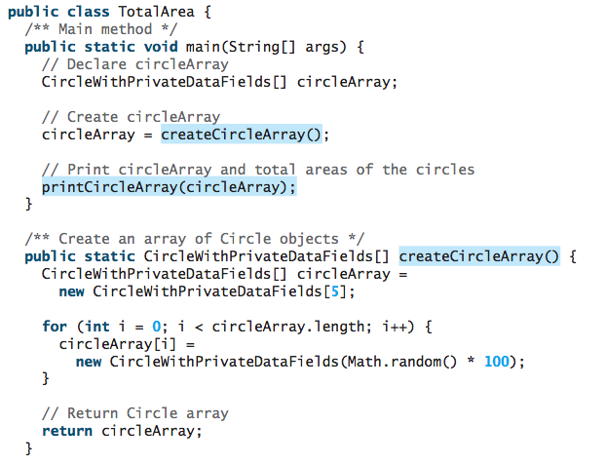
Summarizing the areas of the circles
‹#›

Slide 72
Immutable Objects
Normally, you create an object and allow its contents to be changed later. However, occasionally it is desirable to create an object whose contents cannot be changed once the object has been created. We call such an object as immutable object and its class as immutable class.
If a class is immutable, then all its data fields must be private and it cannot contain public setter methods for any data fields. A class with all private data fields and no mutators is not necessarily immutable.
‹#›

Slide 73
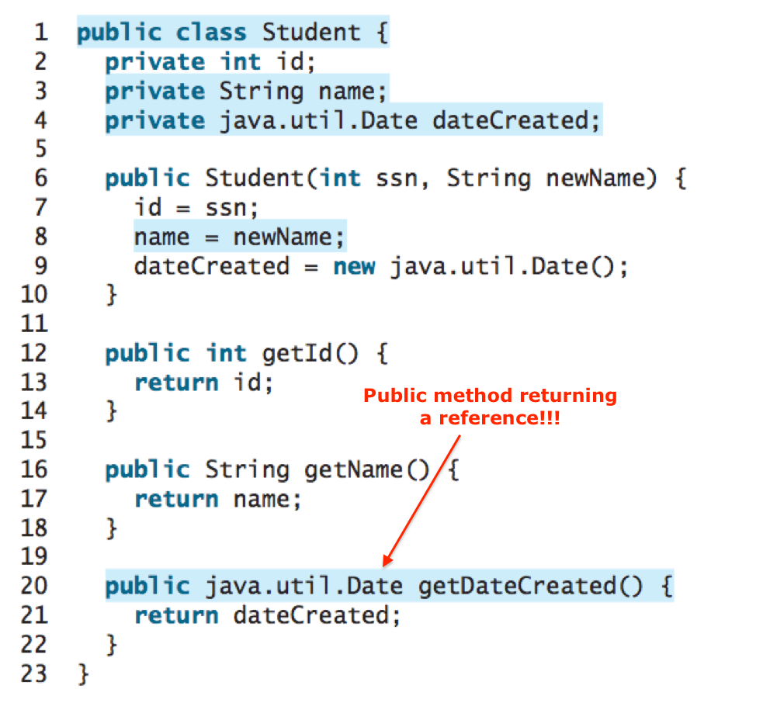
Example
‹#›

Slide 74
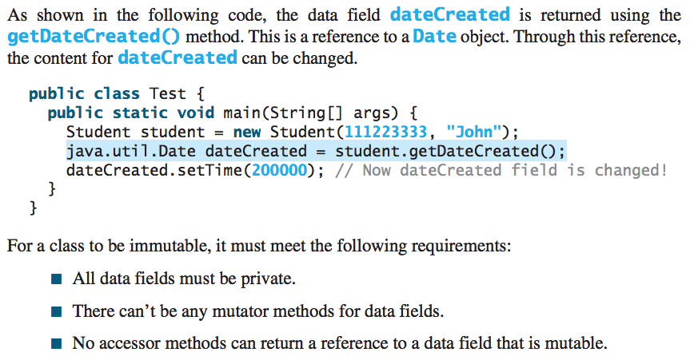
Example
‹#›

Slide 75
Scope of Variables
The scope of instance and static variables is the entire class. They can be declared anywhere inside a class.
The scope of a local variable (i.e. a variable defined in a method) starts from its declaration and continues to the end of the block that contains the variable. A local variable must be initialized explicitly before it can be used.
‹#›

Slide 76
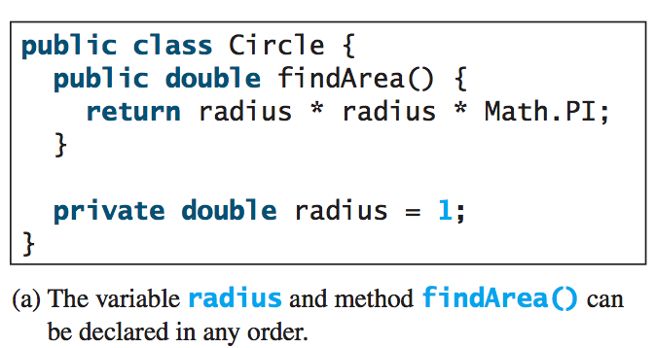
Scope of Variables
‹#›

Slide 77
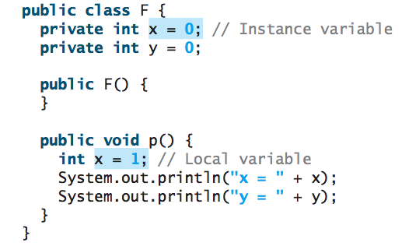
Scope of Variables
If a local variable has the same name as a class’s variable, the local variable takes precedence and the class’s variable with the same name is hidden.
‹#›

Slide 78
The this Keyword
The this keyword is the name of a reference that refers to an object itself. One common use of the this keyword is reference a class’s hidden data fields.
Another common use of the this keyword to enable a constructor to invoke another constructor of the same class.
‹#›

Slide 79
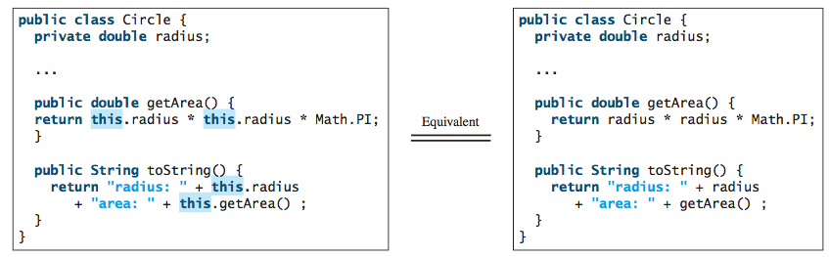
The this Keyword
‹#›

Slide 80
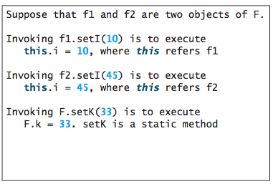
Reference the Hidden Data Fields
The this keyword gives us a way to reference the object that invokes an instance method. To invoke f1.setI(10), this.i = i is executed, which assigns the value of parameter i to the data field i of this calling object f1. The keyword this refers to the object that invokes the instance method setI, as shown below:
‹#›

Slide 81
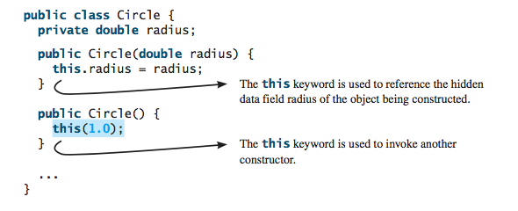
Calling Overloaded Constructor
The this keyword can be used to invoke another constructor of the same class. For example, you can rewrite the Circle class as follows:
‹#›

